Slide 1
Demo 2 – Midterm
The Basics
Camilla Lucero, Cameron Loghry, Alex Snyder

Slide 2
Our Midterm Goals
The General Goal – Have our First Level DONE
Well, what the heck! Why isn’t it done?
Admittedly, we misjudged how much time coding enemies, weapons, interactions, sprites, etc. would take. We were too ambitious for our allotted coding time.

Slide 3
Our Goals for This Week
Have, at least, 2 enemies set up
Slime, small and jumpy enemy
Ghost, medium and flying enemy
Ghost Following proximity – ghost only moves if a PC object is within a certain radius
Menu System
Working Weapons
Implementing health for both enemies and PC
Sprites for moving characters
Power-ups

Slide 4
Why Do These Changes Matter?
Our changes that we plan to execute by next week will start setting up the main parts of our game.
They will set up our main two enemies for the first level, both code and visually.
They will start adding playability via weapons and health systems
They will over all start making our game look like a game!
This is important because it will start giving our game personality besides just moving boxes and give our game functions and things for the player to do.

Slide 5
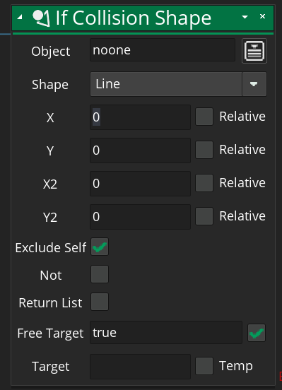
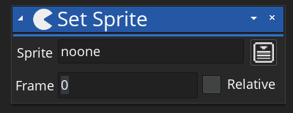
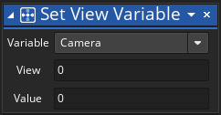
Icons
Sets an object’s sprite to another specified sprite!
We used this to transfer between idle and moving sprites!
Sets camera angle to whatever we like
We used this to have the camera follow the player object
Sets an invisible shape around an object. If an object collides with the shape, returns a boolean.
Used for Enemy Proximity.

